Slide 1
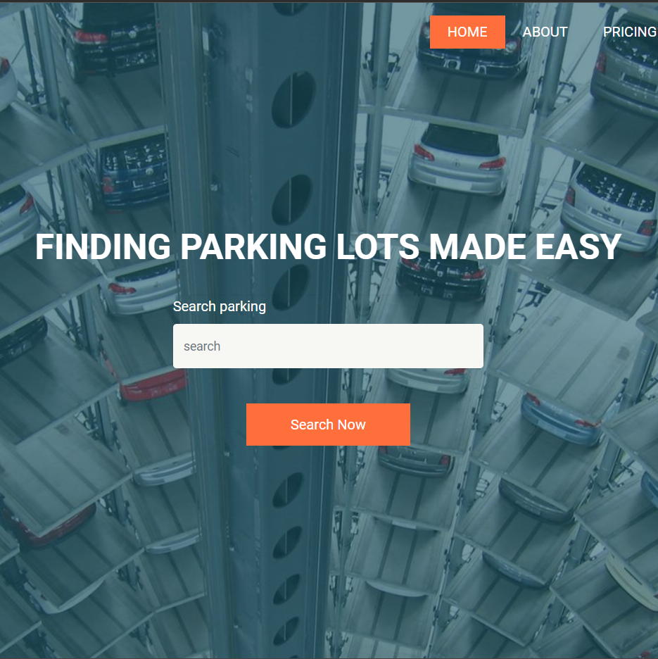
PARKING MANAGEMENT SYSTEM
ALFIN VARGHESE
22PMC108

Slide 2
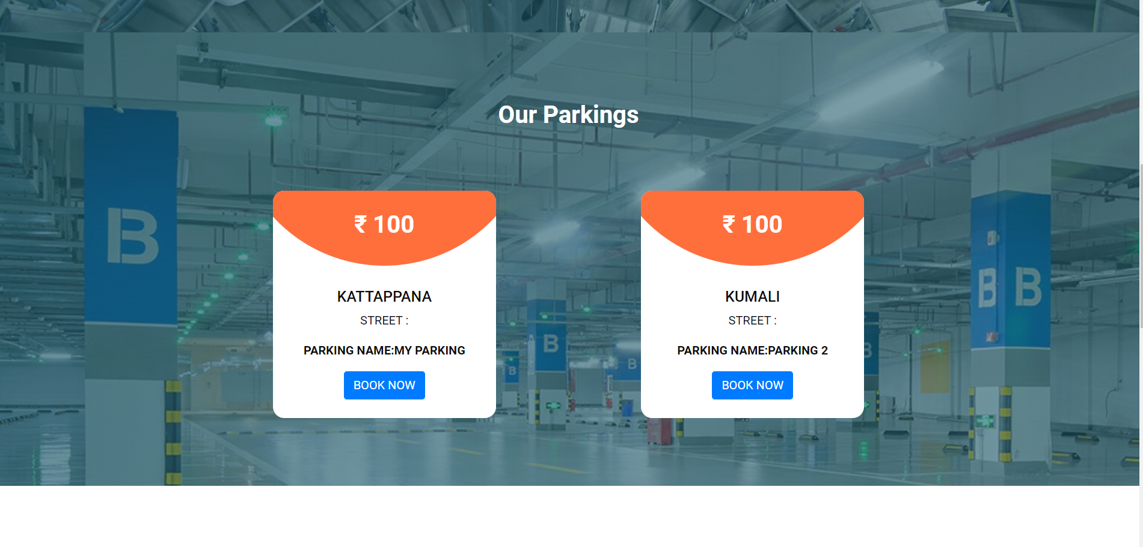
ABSTRACT
The Parking Reservation System is a parking guidance and reservation system in towns. The project contains the admin sides and the user side. The admin can view and manage the users,and manage the parking area.The users are the clients who want to park their vehicles in the parking area. A user has to login first to make the parking pass. If he/she has not registered, they can register first and then login. Then users can book parking slots . Looking for spaces to park can be really hectic in a busy town in regard to walking distance to your destination from your vehicle, safety of the vehicle…etc. If one happens to be a stranger in town it gets more difficult to operate around the town. This project is a very simple project that solves all these parking cycle issues.

Slide 3

Project requirements
1. Register and login for the user.
2. User will be able to give basic details like address, name, vehicle details .
3. The admin can add vehicle ,mange vehicles in and out.
4.Parking Reservation page
5.Payment portal
6. The admin can view and manage the users, manage the parking .
7.The admin can view vehicles between the dates
8.In admin page where there will be notification of the parking requests.
9.Admin can view reports.

Slide 4
FEATURES AND HIGHLIGHTS
1.Users can register and login into the system.
2.Users can search parking places.
3.Users can view different parking locations.
4.Users can add vehicles .
5.In user home page user can edit and view vehicles details.
6.User can take print of booking details.
7.User can book parking slots for their vehicle.
8.If we click book now in slot ,book now will changes to booked state.
9.The available slots number will reduce when booking slots.

Slide 5
FEATURES AND HIGHLIGHTS
10.The Admin can view
1.Todays vehicle entries
2.Yesterdays vehicle entries
3.Last 7 days vehicle entries
4.Total vehicle entries
11.Admin can add Vehicle Category.
12.Admin can edit Vehicle category.
13.Admin can Manage IN and OUT Vehicles.
14.Admin will get between dates report.

Slide 6
Technical aspects
Django
Django is a free and open-source web application framework written in Python. It is used for rapid web development and clean, pragmatic design. It is built by experienced developers to make repetitive tasks easier, so we can focus on writing apps instead of reinventing the wheel.
Django is most often used for web development, but it can be used for many other purposes as well. It is a highly-regarded piece of software and is highly recommended for anyone who is serious about their web development. It can be used to build large e-commerce websites, blogging sites, or anything else that requires a scalable, high-performing website.
Django Architecture
The code has certain functions to perform, the input data is the dataset and how it is stored in the database. It is just a matter of delivering the input to the database in the desired format. The Business Logic is what controls the output of the server in HTML or another format. The HTML and CSS are the pages that it is written for. These days, the approach taken is different. The content is gathered from multiple sources and stored in separate files. This is known as page streaming, and it is a widely used approach for website content. The code for the webpage is stored in one file and the HTML, CSS and JS are stored in separate files. The content is streamed from the server and rendered in the browser. These days, the vast majority of software development is done using web technologies such as JavaScript, HTML, CSS and JAVA, which are familiar to developers. It may come as a surprise that most of the software development is done using these technologies. MVC has a model, view, and controller.

Slide 7
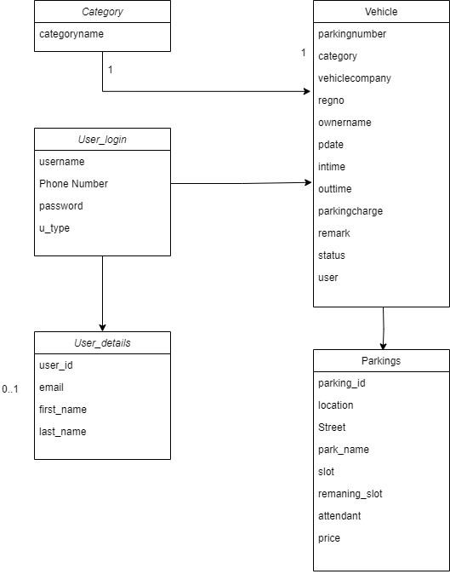
Database class diagram

Slide 8
Challenges faced during the development
User Authentication and Authorization: Implementing a secure and reliable user authentication and authorization system can be challenging. You need to ensure that only authenticated and authorized users can access and perform actions within the reservation system.
Database Design and Management: Designing an efficient and scalable database structure for storing parking-related information can be complex. Plan the database schema carefully, considering factors such as user data, parking lot information, reservations, and availability. Use appropriate indexing and caching techniques to optimize database performance.
Reservation Conflict Resolution: Managing conflicts when multiple users try to reserve the same parking spot simultaneously can be tricky. Implement a mechanism to handle conflicts and ensure that only one user can reserve a spot at a given time. Techniques like optimistic locking or using timestamps can help in resolving conflicts.

Slide 9
Challenges faced during the development
Payment Integration: Integrating payment gateways or implementing a secure and reliable payment system can be challenging. Ensuring secure transactions, handling different payment methods, and managing refunds and cancellations require careful implementation and adherence to security standards.
User Experience and User Interface: Designing an intuitive and user-friendly interface for making reservations can be a challenge. Conduct user research, gather feedback, and iterate on the user interface to provide a smooth and hassle-free experience for users. Focus on usability, responsiveness, and accessibility considerations.
Testing and Quality Assurance: Thoroughly testing the parking reservation system to identify and fix bugs, as well as ensuring its reliability, can be a significant challenge. Implementing unit tests, integration tests, and conducting usability testing can help ensure the system functions as expected and meets user requirements.

Slide 10

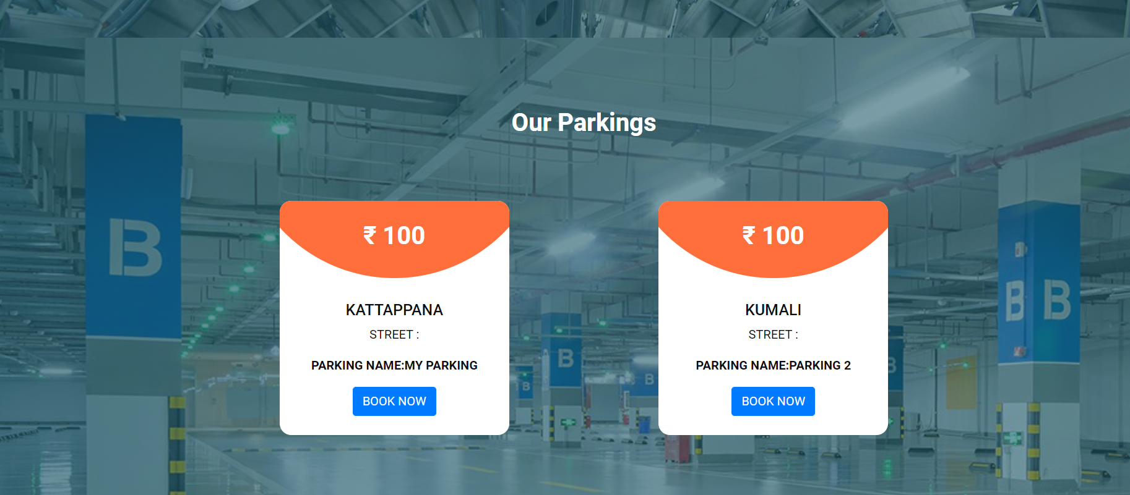
Important Screenshots with explanation

Slide 11
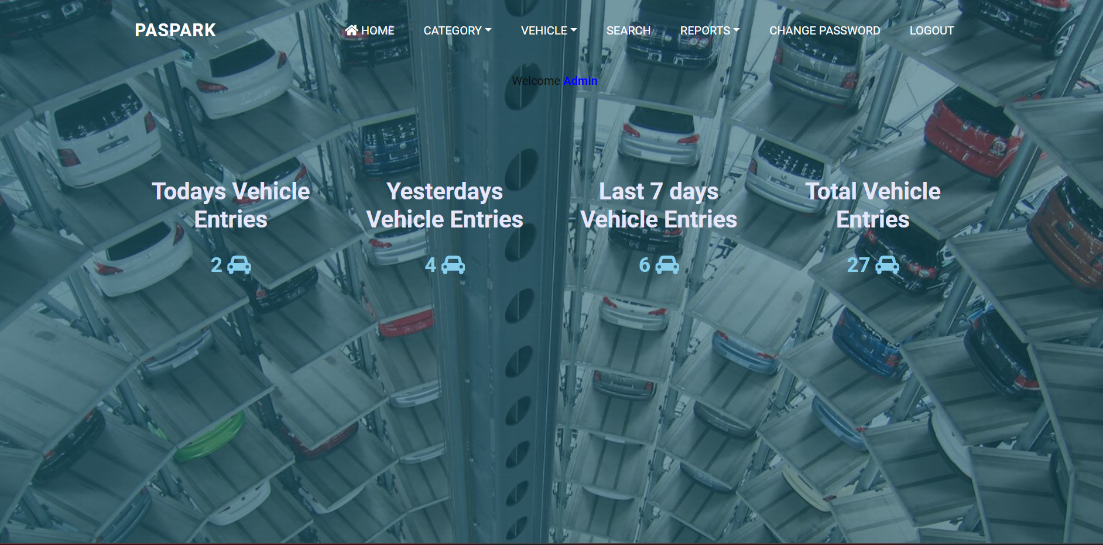
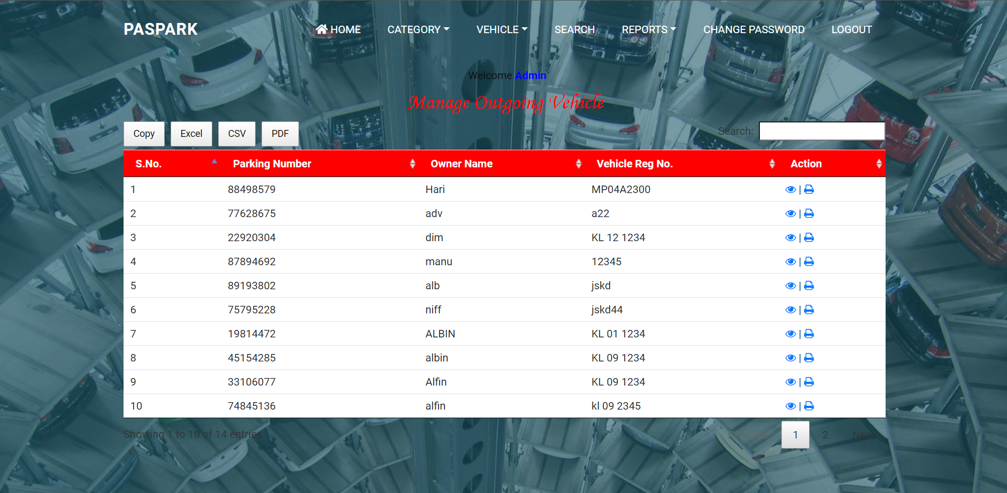
Important Screenshots with explanation

Slide 12
Future enhancements
Mobile Application: Develop a mobile application for the parking reservation system to allow users to easily book parking spaces, receive notifications, and manage their reservations on their mobile devices.
Real-Time Availability: Implement real-time availability updates to provide users with up-to-date information on parking space availability.
Advanced Booking Options: Add advanced booking options such as hourly, daily, weekly, or monthly bookings to accommodate different user needs and preferences.
Loyalty and Rewards Program: Implement a loyalty program to reward frequent users with points, discounts, or exclusive benefits. This can encourage customer retention and increase user engagement.
Pre-Booking and Pre-Payment: Allow users to pre-book and pre-pay for parking spaces in advance, reducing waiting times and providing a seamless parking experience.
Integration with Cashless Payment Systems: Integrate the parking reservation system with cashless payment systems, such as mobile wallets or contactless payment methods, to offer convenient and secure payment options for users.
Analytics and Reporting: Implement analytics and reporting features to provide insights into parking space utilization, popular time slots, revenue generation, and other key metrics.

Slide 13
Conclusion
The project was successfully completed within the time span allotted. All the modules are tested separately and put together to form the main system. Finally, the modules are tested with real data and it worked successfully. Thus the system has fulfilled the entire objective defined. Our goal of developing this project Parking Reservation System has come to a good result without many defects. Online vehicle parking reservation system improves the existing system since we are in computerized world. With this new system is mandatory, it enables the user of the system (client, employee, System administrator) to reserve a parking lot online and this reduces the wasting of time of the clients looking for where to park, increase the safety of the property since the parking lot is numbering. So this system provides all the available best services to all the customers

Slide 14
References

Slide 15
Thank you

